Slide 1
Introduction to Health Care and Public Health in the U.S.
Delivering Health Care, Part 1
Lecture a
This material (Comp 1 Unit 2) was developed by Oregon Health & Science University, funded by the Department of Health and Human Services, Office of the National Coordinator for Health Information Technology under Award Number 90WT0001.
This work is licensed under the Creative Commons Attribution-NonCommercial-ShareAlike 4.0 International License. To view a copy of this license, visit http://creativecommons.org/licenses/by-nc-sa/4.0/.
Notes:
Welcome to Introduction to Health Care and Public Health in the U.S.: Delivering Health Care, Part 1. This is lecture a.
The component, Introduction to Health Care and Public Health in the U.S., is a survey of how health care and public health are organized and how services are delivered in the U.S. It covers public policy, relevant organizations and their interrelationships, professional roles, legal and regulatory issues, and payment systems. It also addresses health reform initiatives in the U.S.

Slide 2
Delivering Health Care, Part 1
Learning Objectives
Describe the organization of health care at the federal, state and local levels
(Lecture a)
Describe the organization of the VA system and Military Health System (Lecture b)
Describe the structure and function of hospital clinical and administrative units (Lecture c)
Describe different types of long term care facilities, with an emphasis on their function (Lecture d)
Notes:
The learning objectives for Delivering Health Care, Part 1 are to:
Describe the organization of health care at the federal, state, and local levels
Describe the organization of the VA system and Military Health System
Describe the structure and function of hospital clinical and administrative units
And, describe different types of long-term care facilities, with an emphasis on their function

Slide 3
Delivering Health Care, Part 1
Learning Objectives – Lecture a
Describe the organization of health care at the federal, state, and local levels
  Overview of the U.S. Department of Health and Human Services (HHS)
  Role of state governments in health care
  Local health care organizations
Notes:
This first lecture describes the organization of health care at the federal, state, and local levels, including the U.S. Department of Health and Human Services, or HHS, state governments, and local health care organizations.

Slide 4
Purpose of the HHS
Provides essential health care for all Americans
Protects the needy or underserved
State, local, and tribal levels
Structure
  Office of the Secretary
  11 operating divisions
Notes:
The HHS is the federal agency that oversees health care for all Americans. It focuses on helping citizens who are needy or underserved. Services are generally provided at the state, local, and Native American tribal levels. The HHS is run by the Office of the Secretary, and includes eleven operating divisions.

Slide 5
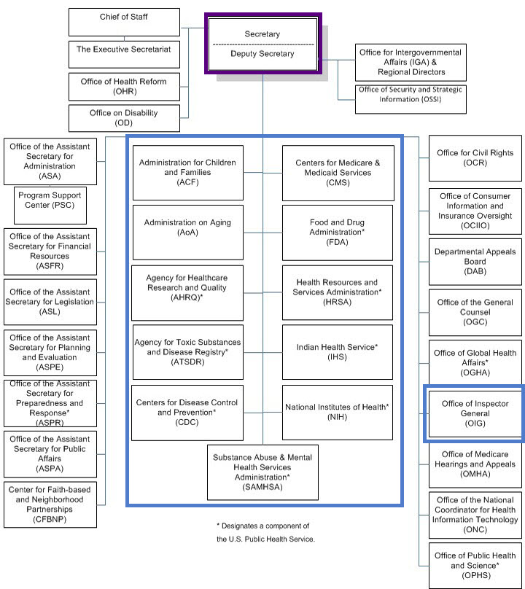
Organization of the HHS
1.1 Chart: (HHS.gov, ND)
Notes:
As illustrated in this flowchart, the structure of the HHS is complex.
At the top, outlined in purple, is the Office of the Secretary, which oversees all operations. This lecture focuses on the inner boxes outlined in blue, which represent the eleven HHS operating divisions. Three of these divisions are considered human services agencies: the Administration for Children and Families, the Administration on Aging, and the Centers for Medicare and Medicaid Services. The other eight divisions are part of the U.S. Public Health Service.
The Office of the Inspector General will also be discussed.
Overall, the HHS runs more than 300 health care programs.

Slide 6
Administration for
Children and Families (ACF)
Addresses the economic and social well-being of children, families, individuals, communities
Vulnerable populations
Programs are both national and regional
Well-known program: Head Start
Notes:
The Administration for Children and Families, or ACF, operates federal programs that encourage economic independence, social well-being, and quality of life. Although this agency targets children and families, it also addresses individuals and entire communities. Vulnerable populations are a special focus, such as people with disabilities, foreign-born individuals, Native Americans, and victims of human trafficking.
One current initiative, "Let's Move! Child Care”, is an effort to promote child health by encouraging physical activity and healthier nutrition practices in early care and education settings.
Another initiative seeks to build the supply and stability of high quality family child care providers. Head Start, a program of the ACF, promotes school readiness among young children by working to improve health, nutrition, educational attainment, and social development. The Early Head Start program targets pregnant women as well as infants and toddlers.

Slide 7
Administration on Aging (AoA)
Adults 65 years of age and older will be 21.7% of the U.S. population by 2040
Programs are both home-based and community-based
Funds non-medical programs to prolong health and independence
Multiple needs served: nutritional, logistical, legal, quality of life
Notes:
Next is the Administration on Aging, or AoA. According to government census projections, people aged 65 and older will represent 21.7% of the population by the year 2040. Individuals who are currently age 65 can expect to live, on average, about another 18 years. Many older people live alone and have a low income, creating an increased need for national programs that target this group.
The AoA provides funding for nonmedical home-based and community-based services for the elderly, with the goal of prolonging the health and independence of senior citizens. Examples of these services are home delivery of meals, nutrition information, transportation services, adult day care, and legal assistance.

Slide 8
Agency for Healthcare Research and Quality (AHRQ) - 1
Mission:
  produce evidence to make health care safer, higher quality, more accessible, equitable, and affordable, and to work within the U.S. Department of Health and Human Services and with other partners to make sure that the evidence is understood and used
All stakeholders are included
  Health care value
Notes:
Decision-making about any issue is difficult when people do not have the information they need. In terms of health care, a good resource for information is the Agency for Healthcare Research and Quality, or AHRQ. AHRQ’s mission is to produce evidence to make health care safer, higher quality, more accessible, equitable, and affordable, and to work within the U.S. Department of Health and Human Services and with other partners to make sure that the evidence is understood and used. The efforts of AHRQ target all stakeholders in the health care system, including patients, individual health care providers, hospitals, insurers, policy makers at all government levels, and medical schools.

Slide 9
Agency for Healthcare Research and Quality (AHRQ) - 2
Helps organizations adopt new technology
Areas of research:
  Effectiveness of treatments
  Quality improvement and patient safety
  Illness prevention and care management
  Health care value
Notes:
AHRQ helps organizations adopt new information technology, such as computerized medical records. It researches the effectiveness of treatments, including drugs, devices, diagnostic tests, and surgery, so patients and physicians can make informed decisions. The agency’s other research interests are quality improvement and patient safety, illness prevention and care management, and issues of health care value, such as the affordability of health care.

Slide 10
Agency for Toxic Substances and Disease Registry (ATSDR) - 1
Works to prevent illness and disease due to toxic or hazardous substances
Common toxins: arsenic, asbestos, lead, mercury
Locations: environmental pollution, waste sites, disasters
Methods of exposure: breathing, drinking, food, soil exposure, cut
Notes:
The Agency for Toxic Substances and Disease Registry, or ATSDR, works to prevent illness and disease due to toxic or hazardous substances. Among the most common toxic substances are arsenic, asbestos, lead, and mercury. Toxic substances may be found in the environment, in specific areas such as waste sites, or due to sudden disasters. People may be at risk from merely breathing, or from contact with water, food, soil or through an open sore like a cut.

Slide 11
Agency for Toxic Substances and Disease Registry (ATSDR) - 2
Identifies exposures, evaluates risk, recommends action
Prepares for emergencies/disasters
Educates about toxicology, environmental medicine, chemical exposures
Issues public health advisories
Example: 9/11/2001
Notes:
The ATSDR identifies potential exposures, quantifies the risk, and makes recommendations for protecting communities. It ensures emergency preparedness for natural or man-made disasters, and it educates health care providers on topics such as toxicology, environmental medicine, and acute chemical exposures. It also issues public health advisories about hazardous materials or physical hazards such as unsafe buildings or abandoned mine shafts.
To give an example, the ATSDR partnered with other government agencies after the terrorist attacks in New York City on September 11, 2001. It provided information about toxin levels and answered questions from residents, first responders, and the media.

Slide 12
Centers for Disease Control and Prevention (CDC) - 1
Responsible for public health
  Protect America from health, safety and security threats, both foreign and domestic
Activities:
  Health promotion
  Disease prevention
  Reduction of injury and disability
  Public Preparedness
Numerous centers, institutes and offices
Notes:
The Centers for Disease Control and Prevention, or CDC, is responsible for public health. The CDC’s mission is to protect America from health, safety, and security threats, both foreign and in the U.S. Major activities include health promotion, disease prevention, reduction of injury and disability, and public preparedness for emerging health threats. The CDC accomplishes these goals through numerous centers, institutes, and offices. Just a few examples are the Center for Global Health, the National Institute for Occupational Safety and Health, the Office of Infectious Disease, and the National Center on Birth Defects and Developmental Disabilities.

Slide 13
Centers for Disease Control and Prevention (CDC) - 2
Works with partners to monitor and investigate threats to health
Enacts prevention strategies, develops public health policies, advocates for healthy behaviors.
Educates health care providers, consumers
Notes:
The CDC works with its partners, both national and international, to monitor current health and to investigate emerging threats to health, for example swine flu. It also enacts prevention strategies and public health policies, and advocates for healthy behaviors. The CDC monitors new threats to the U.S. public, such as infectious diseases that originate in other countries, like the Zika virus. Finally, the CDC offers a wealth of publications on health care topics, some written for health care providers and some written for the public.

Slide 14
Centers for Medicare and Medicaid Services (CMS)
Provides insurance for 1 in 4 Americans
Medicare
  Largest health insurer in the U.S.
  For people 65+ or disabled people
  Insured person pays premiums
Medicaid
  For low-income patients and families
  Specific guidelines are determined by each state
  Insured person generally does not pay
Children’s Health Insurance Program
Notes:
The Centers for Medicare and Medicaid Services, or CMS, provides health care insurance for one in every four Americans. In fact, Medicare is the largest health insurer in the U.S., processing more than one billion claims every year.
Medicare is for people aged 65 and older, along with younger people who have certain disabilities.
Medicare insurance is divided into four parts:
Part A, which is hospital insurance;
Part B, which is medical insurance;
Part C, or Medicare Advantage, which allows the use of private companies approved by Medicare, or provider organizations; and
Part D, which is prescription drug coverage. The insured person may pay monthly premiums depending on the plan selected.
Medicaid is a health insurance program targeted at low-income individuals and families who meet specific requirements. The eligibility rules and the services provided vary by state. Medicaid reimburses the medical provider directly, although some states require the patient to contribute a small co-payment.
Another division of CMS is the Children’s Health Insurance Program, or CHIP. It serves uninsured children and pregnant women who do not qualify for Medicaid but cannot afford private health care insurance.

Slide 15
Food and Drug Administration (FDA)
Ensures safety and effectiveness:
  Food and drugs
  Medical devices
  Animal drugs
  Cosmetics
Evaluates and approves new drugs
Regulates tobacco manufacture and marketing
8 centers with oversight by Commissioner
Notes:
It is well known that the Food and Drug Administration, or FDA, protects the public by ensuring the safety and effectiveness of foods and drugs. The FDA also regulates medical devices, animal drugs, cosmetics, products that emit radiation, and other toxic substances. The FDA evaluates and approves new drugs and regulates the manufacture and marketing of tobacco products. The FDA is organized into eight centers, with oversight by a Commissioner.

Slide 16
Health Resources and
Services Administration
(HRSA) - 1
Improve access to health care for individuals with:
  Low incomes, no insurance
  Certain medical issues
  Isolated
Six bureaus and thirteen offices
Provides leadership and funding to health care providers
Notes:
The Health Resources and Services Administration, or HRSA, works to improve access to health care for individuals who are disadvantaged because of low income, lack of insurance, medical problems, or social isolation. With its six bureaus and thirteen offices, HRSA provides leadership and funding for health care providers who treat uninsured patients, those with HIV/AIDS, pregnant women, special-needs children, rural residents, and others.

Slide 17
Health Resources and
Services Administration
(HRSA) - 2
Monitors organ, blood, bone marrow donations
Supports programs that combat bioterrorism
Compensates people for severe vaccination reactions
Maintains medical malpractice and fraud database
Notes:
In addition to improving access to health care, HRSA monitors national organ, blood, and bone marrow donations; supports programs to combat bioterrorism; compensates patients who sustain severe vaccination reactions; and maintains databases to prevent medical malpractice and fraud.

Slide 18
Indian Health Service (IHS)
Improve physical, mental, social, and spiritual health of American Indians and Alaska Natives
  Accessible public health services
  Culturally sensitive; recognizes sovereign rights
  567 federally recognized tribes in 35 states
Medical and social issues
  Disparities in health and life expectancy
  Higher mortality from diseases, social problems
Notes:
As seen in the previous slides, many HHS agencies target needy, underserved, or rural populations. The Indian Health Service, or IHS, is the federal agency that serves American Indians and Alaska Natives. Its mission is to improve the physical, psychological, and spiritual health of these groups by ensuring access to public health services. Health care for these groups must be delivered in a culturally sensitive manner that recognizes the sovereign rights of tribes. In fact, the U.S. has 567 federally-recognized tribes in thirty-five states, totaling about two million individuals, who mainly reside on reservations, or in rural areas.
Unfortunately, Native populations have poorer health than other Americans. Their life expectancy is a full five years shorter. For American Indians and Alaska Natives born today, their life expectancy is 4.4 years less than the U.S. ‘all races’ population. Sometimes these problems are due to poor education, poverty, discrimination, and cultural misunderstandings. The IHS seeks to address these problems, as well as health disparities.

Slide 19
National Institutes of Health (NIH)
World’s largest source of funding for medical research
Funds universities, research institutions, its own laboratories
27 institutes and centers:
  Diseases
  Specific patient groups
  Research issues
Notes:
The medical research arm of the HHS is the National Institutes of Health, or NIH. This is the largest source of medical research funding in the world, promoting scientific discoveries in every U.S. state and abroad. Research is conducted at universities or research centers, and at NIH laboratories on its own campus.
The NIH is organized into twenty-seven institutes and centers, many of which focus on diseases or body systems. Some well-known examples are the National Cancer Institute, the National Institute of Mental Health, and the National Institute of Diabetes and Digestive and Kidney Diseases. Other institutes and centers focus on specific patient groups, such as children and the elderly, for example through the National Institute on Aging. Still other departments focus on specific research issues.

Slide 20
Office of the Inspector General (OIG)
Protects the integrity of HHS programs
  Performs nationwide audits, investigations
  Reports abuses, fraud, or waste
  Recommends corrections
“Most-Wanted Health Care Fugitives”
  Names and photos
  Providers and public encouraged to help
Notes:
Every society needs to be policed. The Office of the Inspector General, or OIG, works to protect the integrity of HHS programs. It performs nationwide audits and investigations, and it reports any abuses, fraud, or waste to the Office of the Secretary and to Congress. They also recommend corrections.
An important part of the OIG’s work is its ongoing efforts to stop Medicare and Medicaid fraud. It even posts an online list of “Most-Wanted Health Care Fugitives.” The list includes the names and photos of individuals who received millions of dollars in false Medicaid and Medicare claims, then escaped prosecution. Both health care providers and the public are encouraged to help the OIG identify fraud and abuse.

Slide 21
Substance Abuse and Mental Health Services Administration (SAMHSA)
Improves the health of people with mental illness and abuse alcohol, tobacco, or drugs
6 strategic initiatives:
  Prevent substance abuse and mental illness
  Integrate health systems
  Establish a trauma-informed approach in health
  Provide recovery support
  Promote health information technology and electronic medical records
  Promote cultural sensitivity
Notes:
The Substance Abuse and Mental Health Services Administration, or SAMHSA, works to improve the health of people with mental illness and those who abuse alcohol, tobacco, or illegal drugs. The agency provides funding for special programs and disseminates information on behavioral health issues. The rationale is that prevention and treatment reduce health care costs and social costs for individuals, families, and communities.
SAMHSA’s projects are spelled out in six strategic initiatives
Prevent substance abuse and mental illness
Integrate health systems to ensure that behavioral health care services are accessible and connected to the broader health care system
Establish a trauma-informed approach in health, behavioral health, human services, and related systems
Provide mental and substance use disorder recovery support
Promote health information technology and electronic medical records
Promote cultural awareness in health care practitioners

Slide 22
State Health Care
All states have a Department of Health
  Organizational structures vary
  Responsible for disease treatment, health promotion, care of special groups
  State governments partner with HHS
National Academy for State Health Policy
  Works with states to improve health care access and quality
  Encourages collaboration with federal government, private companies, other states
  Example: national health care reform
Notes:
With so much going on at the federal level, what is the role of individual states in providing health care? All states have a department of health, although organizational structures vary. State health departments manage disease prevention and treatment, health promotion, and public health services for special groups, such as racial and ethnic minorities, families, and senior citizens. State and local governments also partner with the HHS to provide these services through state or county agencies or private companies.
Recognizing the disparities in the U.S. health care system, the National Academy for State Health Policy works with states to improve health care access and quality. The Academy encourages states to collaborate with the federal government and private companies, and to share information with other states. Currently, the Agency is working with states as they implement payment reform initiatives related to the Affordable Care Act, the most recent federal health care reform law.

Slide 23
Local Health Care:
Private Health Care Agencies
Independent health care providers
  Single-provider practices
  Group practices
Corporate health care
  Employees, families, retirees
Some agencies operate community health centers
Can have for-profit or nonprofit status
Notes:
Some local governments run clinics and hospitals, but they generally do not provide health care to their residents directly; instead, various types of private organizations fill this need.
Independent health care providers may be single physicians or group practices in the community. Corporate health care refers to self-insured companies that provide health plans and benefits for employees, their families, and retirees.
Community health centers operate in every U.S. state. They provide primary health care services to low-income residents and are supported by public financing.
At all local levels, health care agencies can operate on either a for-profit or nonprofit basis. All community health centers are nonprofit organizations, but so are about 60% of community hospitals, 30% of nursing homes, and 17% of home health care agencies.

Slide 24
Local Health Care: Hospitals
Profit or nonprofit
Government-supported or not
General or specialty
  University-affiliated or community-based
  Single or chain
  Critical-access hospitals get Medicare reimbursement
Notes:
Given the complexity of the U.S. health care system, it is not surprising that many types of hospitals exist. Hospitals may be for-profit or nonprofit, and they may or may not be supported by the government. They may provide general or specialty health care. They may be affiliated with large teaching and research institutions at universities, or they may be based in the community. For-profit hospitals may be single centers, or they may be chains with locations in many states, run by corporations. Critical access hospitals are rural acute care hospitals that are certified to receive reimbursement from Medicare.

Slide 25
Delivering Health Care, Part 1
Summary - Lecture a
HHS
  Described organization of health care at federal, state and local levels
  Provides oversight through eleven operating divisions
States run their own departments
  Accessed locally through private practices, clinics and hospitals
Overall goal – ensure the health of all Americans
Notes:
This concludes lecture a of Delivering Health Care, Part 1.
In summary, this lecture described the organization of health care at the federal, state, and local levels. The HHS provides oversight through its eleven operating divisions. States run their own departments of health, and health care is accessed locally through private practices, clinics, and hospitals. The overall goal is to ensure the health of all Americans.

Slide 26
Delivering Health Care, Part 1
References – 1 – Lecture a
References
Administration for Children and Families. http://www.acf.hhs.gov. Accessed January 19, 2017.
Administration on Aging. http://www.aoa.acl.gov/aging_statistics/index.aspx. Accessed January 19, 2017.
Agency for Health Care Research and Quality. http://www.ahrq.gov. Accessed January 19, 2017.
Agency for Toxic Substances and Disease. Agency for Toxic Substances and Disease Registry. http://www.atsdr.cdc.gov. Updated January 18, 2017. Accessed January 19, 2017.
Alliance for Advancing Nonprofit Health Care. The value of nonprofit health care. http://www.nonprofithealthcare.org/reports/5_value.pdf. Accessed January 19, 2017.
Centers for Disease Control and Prevention. http://www.cdc.gov. Accessed January 19, 2017.
Centers for Medicare and Medicaid Services. CMS programs and information. http://www.cms.gov. Accessed January 19, 2017.
Corporate Health Care Coalition. http://www.corporatehealthcare.org. Accessed January 19, 2017.
Notes:
References slide. No audio.

Slide 27
Delivering Health Care, Part 1
References – 2 – Lecture a
References
Health Resources and Services Administration. http://www.hrsa.gov/index.html. Accessed January 19, 2017.
HHS.gov. http://www.hhs.gov. Accessed January 19, 2017.
Indian Health Service. http://www.ihs.gov. Accessed January 19, 2017.
Indian Health Service. IHS fact sheets: Indian health disparities. https://www.ihs.gov/newsroom/factsheets/disparities/. Updated March 2016. Accessed January 19, 2017.
Medicare.gov. http://www.medicare.gov. Accessed January 19, 2017.
Census Bureau. Medicare & Medicaid. http://blogs.census.gov/2013/09/17/medicare-and-medicaid-age-and-income-2/. Accessed January 19, 2017.
Medline Plus. Medicare. http://www.nlm.nih.gov/medlineplus/medicare.html. Updated March 16, 2011. Accessed January 19, 2017.
National Academy for State Health Policy. http://www.nashp.org. Updated March 2011. Accessed January 19, 2017.
Notes:
References slide. No audio.

Slide 28
Delivering Health Care, Part 1
References – 3 – Lecture a
References
National Association of Community Health Centers. http://www.nachc.org. Accessed January 19, 2017.
National Institutes of Health. http://www.nih.gov. Accessed January 19, 2017.
Office of Inspector General. http://oig.hhs.gov. Accessed January 19, 2017.
Office of the Inspector General. 2016 Work Plan. http://oig.hhs.gov/reports-and-publications/archives/workplan/2016/oig-work-plan-2016.pdf. Accessed January 19, 2017.
Rural Health Information Hub. Frequently asked questions. https://www.ruralhealthinfo.org/topics/critical-access-hospitals#faqs. Accessed January 19, 2017.
Substance Abuse and Mental Health Services Administration. http://www.samhsa.gov. Accessed January 19, 2017.
U.S. Food and Drug Administration. http://www.fda.gov. Accessed January 19, 2017.
Images
Slide 5: US Department of Health and Human Services organizational chart. Available from http://www.hhs.gov/about/orgchart/. Accessed January 19, 2017.
Notes:
References slide. No audio.

Slide 29
Introduction to Health Care and Public Health in the U.S.
Delivering Health Care, Part 1
Lecture a
This material was developed by Oregon Health & Science University, funded by the Department of Health and Human Services, Office of the National Coordinator for Health Information Technology under Award Number 90WT0001.
Notes:
No audio

Slide 30
Introduction to Health Care and Public Health in the U.S.
Delivering Health Care, Part 1
Lecture b
This material (Comp 1 Unit 2) was developed by Oregon Health & Science University, funded by the Department of Health and Human Services, Office of the National Coordinator for Health Information Technology under Award Number 90WT0001.
This work is licensed under the Creative Commons Attribution-NonCommercial-ShareAlike 4.0 International License. To view a copy of this license, visit http://creativecommons.org/licenses/by-nc-sa/4.0/.
Notes:
Welcome to Introduction to Health Care and Public Health in the U.S.: Delivering Health Care, Part 1. This is lecture b.
The component, Introduction to Health Care and Public Health in the U.S., is a survey of how health care and public health are organized and how services are delivered in the U.S. It covers public policy, relevant organizations and their interrelationships, professional roles, legal and regulatory issues, and payment systems. It also addresses health reform initiatives in the U.S.

Slide 31
Delivering Health Care, Part 1
Learning Objectives
Describe the organization of health care at the federal, state and local levels (Lecture a)
Describe the organization of the VA system and Military Health System (Lecture b)
Describe the structure and function of hospital clinical and administrative units (Lecture c)
Describe different types of long term care facilities, with an emphasis on their function (Lecture d)
Notes:
The learning objectives for Delivering Health Care, Part 1 are to:
Describe the organization of health care at the federal, state, and local levels.
Describe the organization of the VA system and Military Health System.
Describe the structure and function of hospital clinical and administrative units.
And describe different types of long-term care facilities, with an emphasis on their function.

Slide 32
Department of Veterans Affairs (VA) Overview
Department of the federal government
Established in 1930
Provides medical care, benefits, social support, memorials
  Serves veterans and their families
  For all branches of military service
Notes:
This lecture discusses the organization of government health care services.
This first slide gives an overview of the Department of Veterans Affairs, which was established as an independent government agency in 1930. Given veterans’ sacrifices on behalf of all Americans, the mission of the VA is to ensure that U.S. veterans and their families receive medical care, benefits, social support, and memorials to honor their service. It is estimated that over 21 million U.S. veterans are alive today, so it is not surprising that the VA is the largest integrated health care system in the U.S.
Veterans include all individuals who have served in the Army, Navy, Air Force, Marines, or Coast Guard. Members of the Reserve or National Guard are also eligible. The spouses, children, and parents of a deceased veteran are also considered family members.

Slide 33
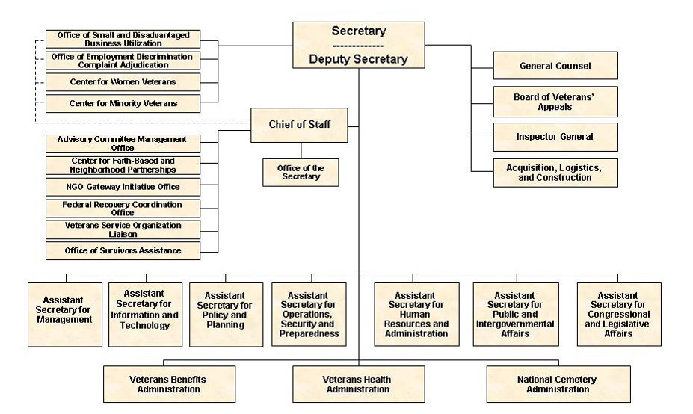
VA Structure
1.2 Chart: (va.gov, ND)
Notes:
This flowchart illustrates how the VA is structured. The Office of the Secretary, at the top, provides oversight. Several specialized offices are listed at the top left, with programs for small business, employment discrimination, women veterans, and minority veterans. Just above the bottom row are offices for information and technology, policy and planning, security and preparedness, human resources, government affairs, and legislative affairs.
At the bottom of the flowchart are three other branches of the VA: the Veterans Health Administration, which manages health care services; the Veterans Benefits Administration, which provides financial assistance; and the National Cemetery Administration, which manages burials and memorials. These three organizations oversee facilities throughout the U.S. This lecture will focus on veterans’ health and veterans’ benefits.

Slide 34
VA Strategic Goals
Empower veterans to improve their well-being
Enhance and develop trusted partnerships
Burial and memorial benefits
Public health, emergency readiness, and socioeconomic well-being
Manage and improve VA operations to deliver seamless and integrated support
Notes:
The VA has five strategic goals. The first is to empower veterans to improve their well-being.
Another is to enhance and develop trusted partnerships with organizations that provide benefits, services, and resources to veterans through improved collaboration, business practices, and outreach.
The VA honors veterans in life, and also after death, through burial and memorial benefits through the National Cemetery Administration.
The VA also works toward national goals of public health, emergency readiness, and socioeconomic well-being.
Finally, the VA strives to manage and improve VA operations, to deliver seamless and integrated support to veterans.

Slide 35
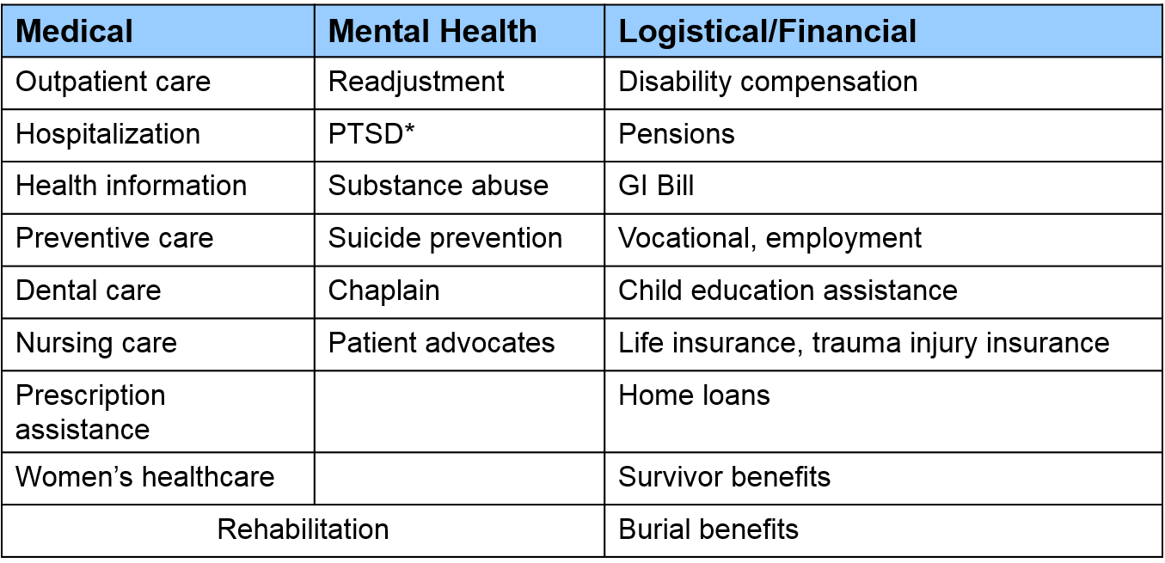
VA Services and Benefits
1.3 Chart: (va.gov, ND)
Notes:
This table lists some of the services that the VA provides. Veterans are entitled to these benefits after discharge from active duty, assuming they were not dishonorably discharged. For convenience, these benefits are classified as medical care, mental health services, and logistical or financial support, as shown in the three column headings.
Examples of medical care, listed in the first column, include outpatient health care at various types of facilities, hospitalization, and information about health issues. Preventive care, dental care, and nursing care are included as available medical care. Preventive care includes disease prevention, smoking cessation, and weight control. Women’s health care and prescription refills are also available as part of medical care.
Mental health services, listed in the second column, address problems of readjustment to civilian life, post-traumatic stress disorder, substance abuse, and suicide prevention. Veterans have access to a chaplain for their spiritual needs. Patient advocates are available at every VA medical center to answer questions, or help veterans deal with any problems or special needs. Rehabilitation is available for psychological as well as physical trauma.
Logistical and financial benefits, as indicated in the third column, include disability compensation, pensions, and the GI Bill, which provides financial aid for college education. Also available are vocational rehabilitation, assistance with employment, educational assistance for veterans’ children, life insurance, traumatic injury insurance, home loans, and benefits for survivors of deceased veterans. In addition, assistance is provided for burials.

Slide 36
VA Capacity
151 Medical Centers
820 Community-based Outpatient Clinics
135 Community Living Centers
103 Domiciliary (Residential) Care Programs
300 Vet Centers
Home health care
Notes:
The numbers on this slide speak to the size and importance of the VA system. Nationwide, it has 151 medical centers, 820 community-based outpatient clinics, 135 community living centers, 103 residential rehabilitation centers, 300 Vet Centers, and 139 Integrated Disability Evaluation System sites. Some VA services are also provided in patient homes.

Slide 37
VA Hospitals
Single hospitals
Health care systems
  Groups of medical centers, clinics
  Share resources; improve efficiency
  Examples
    VA Pittsburgh Healthcare System
    VA Puget Sound Healthcare System
Notes:
There are some specific facilities that offer health-related services to veterans. The most obvious are VA hospitals. Many areas of the country have veterans’ health care systems, which are groups of affiliated medical centers and clinics that share resources to provide comprehensive care more efficiently. Two examples are the VA Pittsburgh Healthcare System in Pennsylvania and the VA Puget Sound Healthcare System in Washington State.

Slide 38
VA Community-Based
Outpatient Clinics
Freestanding clinics
Routine care
Every state and territory
Accessible and convenient
Notes:
Community-based outpatient clinics are freestanding clinics that provide routine outpatient services such as health and wellness visits. They are located in every U.S. state, plus the District of Columbia, American Samoa, Guam, Puerto Rico, the Philippines, and the Virgin Islands. These clinics are intended to be convenient alternatives to traveling to a large medical center.

Slide 39
VA Community Living Centers
Similar to nursing homes
Skilled nursing facilities
Veterans with special concerns
  Chronic health conditions
  Need for rehabilitation
  End-of-life care
Notes:
Community living centers are nursing homes for veterans. Skilled nursing care is available for veterans with chronic conditions such as dementia, those who need rehabilitation services, and those nearing the end of life.

Slide 40
VA Domiciliary Care Program
Oldest element in VA health care system
  Called “soldiers’ homes” in late 1860s
Residential treatment for veterans with:
  Severe medical conditions
  Mental illness, substance abuse, psychosocial problems
Operates with the VA’s Mental Health Residential Rehabilitation and Treatment Programs
Foster healthy behaviors, improve quality of life, integration into society
Notes:
The Domiciliary Care Program is the oldest health component in the VA system. It was established after the Civil War in the late 1860s, when facilities called “soldiers’ homes” began to provide care and housing for disabled and poor veterans. VA domiciliaries are residences that provide treatment and rehabilitation for veterans with severe medical conditions, mental illness, substance abuse disorders, or other psychosocial problems.
The Domiciliary Care Program operates together with the VA’s Mental Health Residential Rehabilitation and Treatment Programs. These programs aim to foster healthy behaviors in a safe living environment, improve quality of life, and help veterans participate in their communities.

Slide 41
VA Vet Centers
Counseling for combat veterans and their families
Every state and territory
Services include help with:
  Readjustment to civilian life
  Medical problems
  Military sexual trauma
  Substance abuse
  Bereavement
Notes:
Vet Centers provide counseling for veterans who have served in a combat zone and for their family members who need assistance coping with military issues. All 50 states, including the District of Columbia and U.S. territories, have Vet Centers.
Counseling services provide help with readjustment to civilian life, medical problems, sexual trauma related to military service, substance abuse, bereavement for families of deceased veterans, and other services.

Slide 42
Home Health Care
Skilled home health care services
  Short term care
  Homebound
  Live in remote location
Homemaker/Home Health Aide services
Home Telehealth services
Notes:
Health care services can also be provided to Veterans in their own home. Skilled Home Care Services involve short-term care that is delivered by a community-based home health agency that has a contract with the VA for veterans who are homebound or live in a remote location. Homemaker and Home Health Aide Services can be utilized to help Veterans remain in their own home. Home Telehealth allows the Veteran’s physician or nurse to monitor the Veteran’s health remotely using home monitoring equipment.

Slide 43
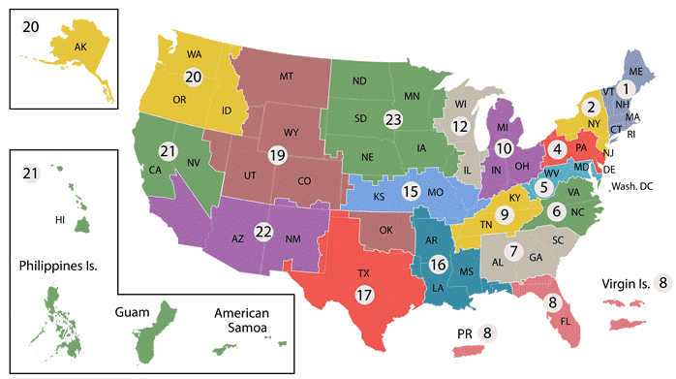
Veterans Integrated
Services Networks
(http://www.va.gov/directory/guide/division.asp?dnum=1, 2016)
Notes:
One of the current concerns about U.S. health care is the fragmentation of services. To minimize this problem, the Veterans Health Administration is divided into twenty-one numbered units called Veterans Integrated Services Networks, or VISN. Each network coordinates and supervises administrative activities and the provision of health care in its region. This map of the U.S. shows the states and territories included in each of the twenty-one units.

Slide 44
Military Health System (MHS): Overview
Operated by the Department of Defense
For U.S. active-duty military personnel and their families
Structure:
  Secretary of Defense for Health Affairs
  Medical departments of the military branches
  Combatant Command surgeons
  Providers in the TRICARE health care program (including private companies)
Notes:
Unlike the VA, which serves veterans and their families after military discharge, the Military Health System, or MHS, covers active-duty U.S. military personnel, wherever they may be serving. The Military Health System is a global medical network operated by the Department of Defense.
The Military Health System is made up of the Office of the Assistant Secretary of Defense for Health Affairs, the medical departments of each of the major military service branches, the Combatant Command surgeons, and the TRICARE providers, including those in the private sector. TRICARE is the managed health care program of the Department of Defense.

Slide 45
MHS: TRICARE Program Overview
Group of managed care plans
  Comprehensive, low-cost options
  Network of physicians, hospitals, pharmacies
  Active duty, retirees, families; all service branches
Most common coverage plans
  TRICARE Prime
  TRICARE Standard
  TRICARE for Life
  TRICARE Reserve Select
  Also overseas options, family care
Notes:
TRICARE is a series of comprehensive, low-cost health plans operated through a network of civilian health care providers, such as physicians, hospitals, and pharmacies. TRICARE serves active-duty service members, retirees, and their families from all seven service branches, including the Army, Navy, Marines, Air Force, Coast Guard, Public Health Service, and the National Oceanic and Atmospheric Administration. Certain National Reserve and National Guard members are also eligible. Besides immediate family members, survivors and certain former spouses may benefit from TRICARE.
Service members may choose from nine TRICARE plans. The most commonly selected plans are listed on this slide.
TRICARE Prime is a health maintenance organization and the most affordable option.
TRICARE Standard is the most flexible option.
Retirees receiving Medicare benefits may enroll in TRICARE for Life as secondary health care coverage.
TRICARE Reserve Select is available for a monthly premium to eligible National Guard and Reserve members.
Other TRICARE plans are targeted at veterans who have been posted outside the U.S., and there is also a family plan as part of TRICARE Prime. Some of the plans require that the veteran assume some of the costs.

Slide 46
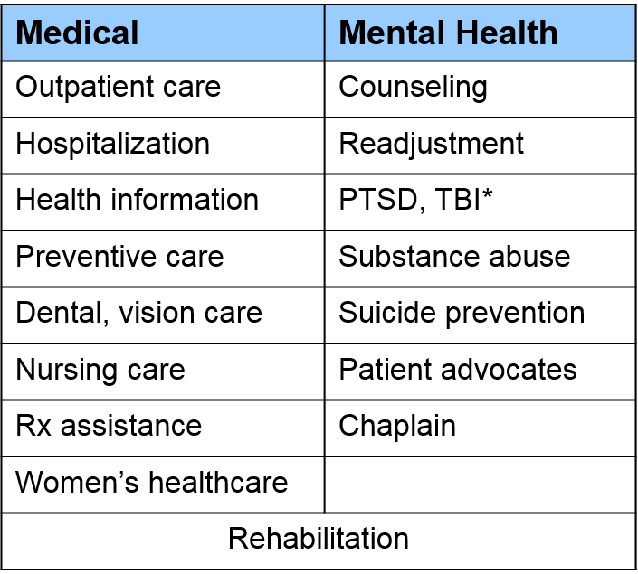
MHS: TRICARE
Program Benefits
1.4 Chart: (MHS.com, ND)
Notes:
This table shows some of the benefits offered through the TRICARE program. Many of the medical and mental health services closely resemble those offered for veterans through the VA system. Most logistical and financial benefits for active-duty military personnel are available through the VA system rather than the Military Health System.
TRICARE medical coverage in column one includes outpatient health care visits, hospitalization, health information, preventive health care, dental and vision care, nursing care, pharmacy benefits, and services for female personnel, such as maternity care.
Programs for mental health in column two include counseling, help in readjusting to civilian life, coping with trauma such as post-traumatic stress disorder and traumatic brain injury, substance abuse problems, and suicide prevention. Personal coaches are on hand to help coordinate medical care, and chaplains are available. Rehabilitation may be needed for physical and/or psychological trauma.

Slide 47
MHS: Goals of
Deployable Medicine
Effective health care wherever troops go
Specific goals include:
  First-responder care
  Essential care (life and limb)
  Definitive care
  Care during transfer to another medical facility
  Logistics (supplies, equipment)
  Education, training, information technology
Notes:
Military conflicts arise all over the world, and the Department of Defense must be able to provide health care services wherever U.S. troops need to go. The Military Health Service provides all of the following types of care.
First-responder care is administered at the point of injury.
Essential care is treatment to preserve life and limb, while definitive care stabilizes or rehabilitates soldiers at the location of conflict.
Care is also provided during transfer to another medical facility, and logistical support optimizes the use of medical supplies, materials, and up-to-date equipment.
The Military Health Service also provides education, training, and medical information technology services.

Slide 48
MHS: Disaster Response
Mass-casualty violence
Homeland defense
Flu outbreak preparedness
Humanitarian assistance after natural disaster
International health initiatives
  North Atlantic Treaty Organization (NATO)
  International Committee of Military Medicine
Notes:
Another function of the Military Health System is disaster response, aimed at protecting the general public as well as members of the military. Such calamities might include mass-casualty violence, emergency operations for homeland defense, flu outbreaks that require medications and vaccines, humanitarian assistance after natural disasters, and global health initiatives. The Military Health System is represented in the North Atlantic Treaty Organization, or NATO, and the International Committee of Military Medicine.

Slide 49
MHS: Education and Research
Education
  Walter Reed National Military Medical Center
  Defense Medical Readiness Training Institute
  Joint Theater Trauma System (JTTS) Clinical Practice Guidelines
  Tactical Combat Casualty Care
Research
  Congressionally Directed Medical Research Programs
  Military Infectious Diseases Research Program
  TriService Nursing Research Program
Notes:
To ensure excellent health care for active-duty personnel, the Military Health System provides education, training, and resources for health care providers. The Walter Reed Army Medical Center and the National Naval Medical Center are two well-known hospitals that came together in September of 2011, to form Walter Reed National Military Medical Center. This large teaching and referral institution is affiliated with universities and treats wounded soldiers from the wars in Afghanistan and Iraq.
The educational programs of the Military Health System include, among others, the Defense Medical Readiness Training Institute, which offers courses in trauma care, burn treatment, disaster preparedness, humanitarian assistance, and other types of military emergency response. The Joint Theater Trauma System, or JTTS, Clinical Practice Guidelines are medical protocols developed by the Joint Theater Trauma System, part of the U.S. Army Institute of Surgical Research. Tactical Combat Casualty Care is a training course for medics, corpsmen, and other rescue personnel who are deployed in areas of combat.
The Military Health System also supports and performs research at military treatment facilities and laboratories. Many projects are supported by federal funds from within the Department of Defense, but funding also comes from the VA and from the Department of Health and Human Services. One example of military research is the Congressionally Directed Medical Research Programs, which study various diseases of concern to all Americans. The Military Infectious Diseases Research Program investigates vaccine and drug development. A final example is the TriService Nursing Research Program, which supports military nursing research.

Slide 50
Delivering Health Care, Part 1
Summary – Lecture b
VA
  Department of the federal government
  Serves veterans after discharge
MHS
  Run by the U.S. Department of Defense
  Serves veterans during military service
Common goals
  Benefit all service members and their families
  Maximize physical and mental health
  Provide logistical and/or financial assistance
Notes:
This concludes lecture b of Delivering Health Care, Part 1.
In summary, the VA and the Military Health System provide health care and other benefits for those who serve the U.S. The VA is a federal department and serves veterans after their discharge from service. The Military Health System is operated by the Department of Defense, and it serves veterans during their military service. Both organizations offer benefits to all uniformed personnel and their families. The goals are to enhance physical and mental health, provide logistical or financial assistance, and thank veterans and active-duty personnel for their service to the country.

Slide 51
Delivering Health Care, Part 1
References – 1– Lecture b
References
Department of Veterans Affairs. 2010 Organizational Briefing Book. Washington, DC: Office of Human Resources and Administration, Office of Administration; 2010.
Military Health System. Frequently asked questions (FAQs): general MHS questions. http://www.health.mil. Accessed January 19, 2017.
Military Health System. TRICARE. http://www.tricare.mil. Accessed January 19, 2017.
U.S. Army 20th Support Command. Chemical, Biological, Radiological, Nuclear, High-Yield Explosives. http://www.cbrne.army.mil. Accessed January 19, 2017.
U.S. Department of Veterans Affairs. http://www.va.gov. Updated January 13, 2017. Accessed January 19, 2017.
U.S. Department of Veterans Affairs. http://www.benefits.va.gov/gibill/. Accessed January 19, 2017.
U.S. Department of Veterans Affairs. 2014-2020 Strategic Plan. http://www.va.gov/op3/docs/strategicplanning/va2014-2020strategicplan.pdf. Accessed January 19, 2017 .
Notes:
References slide. No audio.

Slide 52
Delivering Health Care, Part 1
References – 2 – Lecture b
References
U.S. Department of Veterans Affairs. Home healthcare. http://www.va.gov/healthbenefits/access/home_health_care.asp. Accessed January 19, 2017.
Walter Reed National Military Medical Center. http://www.wrnmmc.capmed.mil/About%20Us/SitePages/Home.aspx. Accessed January 19, 2017.
Images
Slide 13: Map of Veteran’s Integrated Services Network , or VISN, units in the US. Available from http://www2.va.gov/directory/guide/division.asp?dnum=1. Accessed January 19, 2017.
Charts, Tables, Figures
1.2 Chart: Organizational chart for the Department of Veterans Affairs. Structure of the VA. Available from http://www.va.gov/ofcadmin/docs/vaorgchart.pdf. Accessed January 19, 2017.
1.3 Chart: VA Services.
1.4 Chart: Post-traumatic stress disorder, traumatic brain injury
Notes:
References slide. No audio.

Slide 53
Introduction to Health Care and Public Health in the U.S.
Delivering Health Care, Part 1
Lecture b
This material was developed by Oregon Health & Science University, funded by the Department of Health and Human Services, Office of the National Coordinator for Health Information Technology under Award Number 90WT0001.
Notes:
No audio

Slide 54
Introduction to Health Care and Public Health in the U.S.
Delivering Health Care, Part 1
Lecture c
This material (Comp 1 Unit 2) was developed by Oregon Health & Science University, funded by the Department of Health and Human Services, Office of the National Coordinator for Health Information Technology under Award Number 90WT0001.
This work is licensed under the Creative Commons Attribution-NonCommercial-ShareAlike 4.0 International License. To view a copy of this license, visit http://creativecommons.org/licenses/by-nc-sa/4.0/.
Notes:
Welcome to Introduction to Health Care and Public Health in the U.S.: Delivering Health Care, Part 1. This is lecture c.
The component, Introduction to Health Care and Public Health in the U.S., is a survey of how health care and public health are organized and how services are delivered in the U.S. It covers public policy, relevant organizations and their interrelationships, professional roles, legal and regulatory issues, and payment systems. It also addresses health reform initiatives in the U.S.

Slide 55
Delivering Health Care, Part 1
Learning Objectives
Describe the organization of health care at the federal, state and local levels (Lecture a)
Describe the organization of the VA system and Military Health System (Lecture b)
Describe the structure and function of hospital clinical and administrative units (Lecture c)
Describe different types of long term care facilities, with an emphasis on their function (Lecture d)
Notes:
The learning objectives for Delivering Health Care, Part 1 are to:
Describe the organization of health care at the federal, state, and local levels.
Describe the organization of the VA system and Military Health System.
Describe the structure and function of hospital clinical and administrative units.
And, describe different types of long-term care facilities, with an emphasis on their function.

Slide 56
Delivering Health Care, Part 1
Learning Objectives – Lecture c
Describe hospitals and outpatient clinics.
Relevant facilities include:
  Individual and group physician practices
  Health maintenance organizations (HMOs)
  Preferred provider organizations (PPOs)
  Urgent or immediate-care clinics
  Hospitals
  Hospital systems
Notes:
This lecture discusses outpatient and inpatient care facilities.
Relevant health care facilities include individual and group physician practices, health maintenance organizations, or HMOs, preferred provider organizations, or PPOs, urgent or immediate-care clinics, and hospitals. The different types of hospitals and their clinical and corporate structures, including hospital systems, will be discussed.

Slide 57
Sole Proprietorship Clinic
Functions as a small private office
Run by a single physician with a small staff
Owner assumes all obligations/liabilities
This type of practice is increasingly rare
Notes:
A sole proprietorship outpatient clinic is generally a small private office in which a physician works alone, assisted by one person or, at most, a few medical assistants and administrative personnel. Because of legal and financial liabilities for the physician, this form of practice is increasingly rare.

Slide 58
Group Practice Clinic
Partnership includes 2 or more physicians
Corporate group practice:
  Corporation owns the practice
  Physicians are employees
Independent Practice Association (IPA)
  Practice is a legal entity (e.g., corporation)
  Each physician has a separate office
  Physicians own the practice
  May contract with HMOs to provide health care
Notes:
Two or more physicians may practice medicine together in what is called a partnership. One or both of the “partners” can actually be a corporation, rather than a person. In a corporate group practice, a hospital or corporation owns the practice and the physicians are employees, each earning a salary.
An Independent Practice Association, or IPA, is another type of group practice where physicians work together to provide services while sharing economic risk. The IPA is a registered legal entity such as a corporation, a partnership, or a foundation. Each physician runs his or her own office, maintaining separate medical records, support staff, and professional identities. The physicians themselves own the IPA. Although distinct from HMOs, IPAs may contract with HMOs to provide services to HMO patients.

Slide 59
Managed Health Care
HMO
  Prepaid health plan
  Physicians are paid per patient
  Patient pays co-payments for service, obtains referrals for specialty care
PPO
  Physicians are independent
  Patient pays fees but does not need referrals
Point-of-Service Plan
  Works as a combination of HMO and PPO
Notes:
Managed care began in the late 1970s in an attempt to improve health care while controlling costs. An HMO is a prepaid health plan that provides health care for members and their families. The HMO contracts with physicians and hospitals, which are called the provider network. The HMO pays the physician a certain amount for each patient, and the patient pays a small fee, or co-payment, at each visit. Patients must use providers in the network and obtain a referral before accessing specialty care.
A PPO is similar to an HMO, except that the physicians operate independently. The PPO network may be organized by an insurance company, an employer, or by the physicians themselves. Plan members pay a deductible and a co-payment. Members do not need a referral to see a specialist, but fees may be lower if they do obtain a referral.
Point-of-service plans are essentially a combination of HMOs and PPOs. Patients can use physicians in the provider network, as in an HMO, but they can also go out of network without a referral, as in a PPO. The catch is that out-of-pocket costs are higher for using the PPO option.

Slide 60
Urgent Care Centers
Also called immediate care centers
For acute illness or injury not serious enough for a hospital emergency department (ED)
  Capability is intermediate between retail clinic and ED
  Service is available on walk-in basis
  Extended hours
Advantageous for U.S. health care system
  Provide more health care for more people
  Reserve EDs for life-threatening emergencies
Notes:
There are different types of health care facilities where patients receive medical care. Urgent care centers, also called immediate care centers, are community clinics that provide care on a walk-in basis. These centers are intended for acute illnesses or injuries that need immediate care but are not serious enough for a hospital emergency department, or ED.
The word “acute” refers to an illness that has started or worsened in a fairly short amount of time.
Urgent care centers do not have all the medical capabilities or around-the-clock operation characteristic of an ED. However, they are better equipped and have longer office hours than general clinics. Urgent care centers are considered advantageous to the health care system, because they allow more people to access care, and they reserve EDs for more life-threatening conditions.

Slide 61
Community Health Centers
Provide primary care for disadvantaged persons
  Treat those who cannot pay and/or have no insurance
  Found in all 50 states and territories
  Usually rely on public financing
Advantageous for U.S. health care system
  Improve health care access for all
  Reserve EDs for true emergencies
Community mental health centers also exist
Notes:
One of the reasons people use ERs is that they cannot pay for health care. To alleviate this problem, community health centers provide primary care for all individuals, regardless of insurance status or ability to pay. Located in all 50 states and U.S. territories, community health centers treat those living in poverty, people experiencing homelessness, public housing residents, migrant workers, and others. Most community health centers rely on public financing. Like urgent care clinics, community health centers enhance access to health care and treat people who would otherwise go to hospital EDs.
Community mental health centers provide mental health outpatient services to similar populations.

Slide 62
Community Hospitals
Defined as non-federal, short-term, general public hospitals
  Provide general or specialty care
  Operate on for-profit or nonprofit basis
Advantageous for U.S. health care system
  Well-suited for routine illness/surgery
  Provide cost-effective and accessible care
Notes:
Community hospitals are technically defined as non-government, short-term general hospitals that are open to the public. Despite the designation of “general,” some community hospitals specialize in certain fields, such as obstetrics and gynecology, rehabilitation, or orthopedics, and some are academic or teaching institutions. Community hospitals may operate on a for-profit or nonprofit basis.
Community hospitals play an important role in the delivery of health care. They are perfectly suited for routine illnesses or surgery, providing a cost-effective and accessible option for local residents.

Slide 63
Teaching/Research Hospitals
Large institutions affiliated with medical schools
  Latest medications, surgical procedures, equipment, technology
  Treat complex medical problems, rare diseases
  Teach physicians and other health care providers
  Support and perform medical research
  Offer special services
  Accept uninsured patients
Example:
  Massachusetts General Hospital
Notes:
Teaching and research hospitals are usually large institutions affiliated with medical schools. Physicians there are aware of all the latest medications, surgical procedures, equipment, and technology. Because of this, teaching hospitals are capable of treating complex medical problems, such as rare diseases, and they perform special types of surgery. Teaching hospitals provide instruction for physicians and other health care providers, support and perform medical research, offer special services such as burn centers, and perform a charitable function by treating uninsured patients.
A well-known example of a teaching hospital is Massachusetts General Hospital in Boston, which is affiliated with Harvard Medical School.

Slide 64
Critical Access Hospitals
Certified for reimbursement by Medicare
Typically are licensed acute-care hospitals in rural locations
Sometimes health clinics are eligible
  Reimbursement may save the hospital from closing
Notes:
A critical access hospital is one that is certified to receive Medicare reimbursement for services. Medicare is the government insurance program for older people and some people with long-term disabilities. Typically, critical access hospitals are acute care hospitals in rural areas, although smaller health clinics may be eligible. In many cases, Medicare reimbursement saves these hospitals from having to close because of financial difficulty. They can therefore continue to provide services in areas that may otherwise lack hospital care.

Slide 65
Health Care Accreditation
The Joint Commission certifies medical care facilities
  Oldest and largest health care accrediting body
  Independent nonprofit organization
  Certifies nearly 21,000 organizations and programs in the U.S.
Organizations must undergo periodic site visits to identify and resolve problems
Notes:
It is important to note that hospitals and other health care facilities are accountable for their performance. In the U.S., an organization called the Joint Commission evaluates and certifies medical care facilities. The goal of the Joint Commission is to improve the effectiveness, safety, and overall value of health care. The Joint Commission is the oldest and largest accrediting body for health care in the U.S., and its judgments are considered fair because it is an independent nonprofit organization.
The Joint Commission certifies nearly 21,000 organizations and programs in the U.S., including hospitals, urgent care centers, ambulatory clinics, surgery centers, and laboratories. These organizations undergo periodic on-site visits to identify and resolve problems.

Slide 66
Hospital Clinical Structure: Overview
Structured according to type and level of care
  Similar inpatients – wards
  Specialized areas
    Emergency department
    Operating room
    Intensive Care Units (ICU)
      Cardiac Care Unit (CCU)
Care provided by physicians and nurses
  May have specializations
  Assisted by ancillary personnel
Notes:
Hospitals are structured according to type and level of care. Areas of the hospital with similar inpatients are called wards, such as the maternity ward or the pediatric ward for children. An “inpatient” is simply a person who has been admitted to the hospital. Other specialized areas include the emergency department, or ED, the operating room, or, and the intensive care unit, or ICU. There are different types of ICUs for specific patients; for example, a CCU is a cardiac care unit.
Health care is provided mainly by physicians and nurses. Physicians may specialize in various types of medicine. All departments are assisted by ancillary personnel, who perform specific technical tasks.

Slide 67
Hospital Setup: ED
ED is open 24 hours, 7 days a week
Treats various types of injuries
  Ranging from ankle sprain to drug overdose
  Severity is assessed by a process called triage
Patients are treated completely or sent to other departments
Notes:
Practically everyone has heard of the hospital ED, if only because of TV dramas. Open twenty-four hours a day, every day, the ED treats patients with a range of medical problems, whether relatively minor, such as an ankle sprain, or life-threatening, such as a heart attack, a drug overdose, or serious injuries. Physicians and nurses in the ED evaluate patients by a process called triage, whereby the sickest patients are treated first. After patients are treated, they may be able to go home right away. Those with more serious conditions are transferred to other areas of the hospital, possibly the ICU or CCU, for further care.

Slide 68
Hospital Setup: OR
Surgery is done in the OR
  Sterile environment is required
  Surgical team includes a variety of health care workers
  Contains surgical instruments, monitoring equipment, emergency equipment
Surgery centers
  Freestanding, not part of a hospital
  Perform operations on outpatient basis
  Subject to Joint Commission certification
Notes:
The OR, of course, is where surgery takes place. The environment is kept sterile, or free of germs, to prevent infection in the patient. The surgical team generally includes one or more surgeons, various nurses with specialized roles, and an anesthesiologist, who makes sure the patient is safely unconscious. Surgical instruments vary, depending on the operation to be performed. Equipment is available to monitor the patient’s vital signs and to resuscitate the patient in case of emergency.
Surgery is also performed at freestanding surgery centers, which are separate from hospitals. Operations are done on an outpatient basis, meaning that the patient goes home directly afterward. As mentioned earlier in this lecture, surgery centers are also subject to Joint Commission certification.

Slide 69
Hospital Setup: ICU/CCU
ICUs treat patients with severe disease or injury
  Pneumonia
  Traumatic injury
CCUs are for cardiac (heart) disease
Patients come from ED, OR, or another hospital
Sophisticated equipment is used
Notes:
The ICU is a separate area of the hospital for treatment and continuous monitoring of very ill patients. Many kinds of illnesses may need ICU care, including lung conditions such as pneumonia and emphysema; sepsis, or blood infection; and traumatic injuries. As mentioned earlier, CCUs are ICUs dedicated to patients with cardiac, or heart, disease.
Patients may come to the ICU from another section of the hospital, such as the ED or the OR, or they may arrive after transfer from a different hospital. Machines in the ICU monitor the patient’s vital signs, such as breathing and heart rate. Various tubes may be inserted to give medicine, provide nutrition, or drain urine, and mechanical ventilators may be used to help with breathing. The need for other sophisticated equipment depends on the patient’s condition.

Slide 70
Personnel Who Provide Serious Acute Care - 1
Emergency Medicine
  Encompasses verity of medical problems
  Specialty dedicated to life threating problems
  Short term care
EMTs and Paramedics
  Perform basic care
  Paramedics have extra training
Notes:
In most cases, people who provide acute care are emergency medicine physicians and critical care physicians, along with nurses and other personnel working as a team. Serious acute care encompasses medical problems such as heart attack, stroke, unexpected childbirth, or sudden complications of surgery. It also includes accidents such as poisoning, or trauma from such events as car crashes, gunshot or stab wounds, falls, or burns.
Emergency medicine is a medical specialty dedicated to saving patients with life-threatening problems. It is a high-stress field where physicians must make difficult decisions quickly, often with limited information about the patient. The goal is short-term care, to immediately stabilize the patient so he or she can move on to more definitive treatment.
Emergency physicians work in EDs. When possible, however, patients receive treatment from emergency medical technicians, or EMTs, before reaching the hospital. EMTs travel to sites of emergencies, perform basic medical care, and transport patients to hospitals by ambulance. Paramedics are EMTs with extra training that allows them to perform some medical procedures right at the scene, before transport.

Slide 71
Personnel Who Provide Serious Acute Care - 2
Critical care
  Specialty – life threatening conditions
  Focus is long term care
  Sent to ICU or CCU once stabilized
Notes:
Like emergency medicine, critical care is a specialty for treating patients with life-threatening conditions. In critical care medicine, however, the focus is on long-term care. The sickest patients are sent to the ICU or CCU after they are stabilized.

Slide 72
Other Hospital Personnel - 1
Surgeons
  Perform operations
  Special types
    Orthopedic surgery
    Plastic surgery
Anesthesiologists
  Monitor patients in the OR
  Treat pain
    In the ICU
    During childbirth
Notes:
Hospitals employ many types of personnel. In the OR, of course, there are both surgeons and anesthesiologists. Surgeons perform operations, and many specialize in certain fields, such as orthopedic surgery, cardiovascular surgery, or plastic surgery.
Anesthesiologists care for patients during surgery by monitoring their body functions while they are unconscious. They also treat pain outside the OR, such as in the ICU, during childbirth, and in medical conditions associated with chronic pain.

Slide 73
Other Hospital Personnel - 2
Other physician specialties
  Internal medicine
  Cardiology
  Obstetrics/gynecology
  Psychiatry
Medical subspecialties
  Pediatric cardiology
  RNs, LPNs, and PAs may also specialize
  Pharmacists evaluate and dispense medications
Notes:
Medical specialties of physicians include general internal medicine, cardiology, obstetrics and gynecology, and psychiatry, among many others. There are even medical subspecialties, such as pediatric cardiology.
Registered nurses, or RNs, licensed practical nurses, or LPNs, and physician’s assistants, or PAs, are thoroughly trained in their own right, and some of them specialize in certain fields of medicine.
Pharmacists are licensed professionals who usually have a doctor of pharmacy degree. They are essential members of the hospital team who coordinate care activities, monitor patients for changes in physical condition, dispense medications, and provide support to patients and family members.

Slide 74
Ancillary Personnel
Nursing assistants work under the direction of RNs and LPNs
Technicians help with treatment or diagnosis
Rehabilitation personnel include PTs, OTs, respiratory and speech therapists
Other workers educate and counsel
  Dietitians/nutritionists
  Diabetes educators
  Social workers
Notes:
All hospitals employ personnel to provide ancillary services for diagnosis, treatment, rehabilitation, and education.
Nursing assistants provide for the patient’s most basic needs, under the supervision of RNs or LPNs.
The various types of technicians include phlebotomists, who are trained to take blood; x-ray and ultrasound technicians; and laboratory personnel.
Rehabilitation personnel include physical therapists, occupational therapists, respiratory therapists, and speech therapists.
Other hospital workers educate or counsel patients; these include dietitians, nutritionists, diabetes educators, and social workers.
This is only a sampling of the roles that exist in hospital settings today.

Slide 75
Hospital Corporate Structure
Governing board provides oversight
Chief executive officer responsible for daily operations
Administration also includes chief officers, department heads, patient care managers
Medical staff and ancillary personnel provide health care and technical services
Non-medical services are also critical
Business office does paperwork
Notes:
The corporate structure of hospitals includes a governing board, or board of directors, that provides oversight. For nonprofit hospitals, the board of directors may be a religious order or influential figures in the health care community. Hospitals affiliated with universities may have the same board of directors as the university.
In any corporation, the chief executive officer is responsible for daily operations. Most hospitals also designate chief medical officers, nursing officers, information officers, financial officers, and operating officers.
Each department in a hospital has a head administrator who is responsible for its performance. In addition, departments are likely to have managers who oversee patient care, such as supervising physicians and nurse managers.
Nonmedical service personnel, such as cooks and laundry workers, are also critical, as is the hospital business office that deals with such issues as billing and insurance, scheduling, maintenance of medical records, personnel issues, and reports and budgets.

Slide 76
Hospital Financing
Ownership may be public or private
  Public hospitals are funded by the government, may have limited resources
  Private hospitals are run by private entities, may have greater resources (for example, finances, equipment)
Either type of hospital may be for-profit or nonprofit
Notes:
Hospitals may be publicly or privately owned and funded, and they may be either for-profit or nonprofit. A public hospital is funded by the government and therefore may have limited financial resources. A private hospital is owned by a private organization, such as a medical insurance company. It tends to have greater capital and more up-to-date equipment, so its services may be more expensive.

Slide 77
Hospital Systems
Defined as two or more hospitals owned by a corporation, with a single board of directors
Network - group of hospitals, physicians, and other entities that collaborate to provide care
Example
  Greenville Hospital System University Medical Center
  Nonprofit in South Carolina
  Has multiple locations
Notes:
A hospital system consists of two or more hospitals or other health care facilities that are owned, leased, or managed by an organization such as a corporation. Oversight is provided by a single board of directors. Single hospitals can be part of a hospital system if they own or lease other health care facilities.
Health care networks are groups of hospitals, physicians, other health care providers, insurers, and/or agencies that collaborate to provide many types of health care in a community.
One example of a hospital system is the Greenville Hospital System University Medical Center, a nonprofit organization located in South Carolina. The system includes five major medical centers and other facilities.

Slide 78
Delivering Health Care, Part 1
Summary – 1 – Lecture c
Facilities range from single-physician offices to large hospital systems
Most people have a managed care plan
Community centers and clinics offer range of services
Notes:
This concludes lecture c of Delivering Health Care, Part 1.
In summary, health care facilities range from small offices of single physicians to large hospital systems. Most people obtain health care through managed care plans of various types. Community centers and freestanding clinics offer a range of services, from acute medical care or mental health care to outpatient surgery.

Slide 79
Delivering Health Care, Part 1
Summary – 2 – Lecture c
Hospitals treat patients, research and teaching, and charitable roles
All health care facilities must prove efficacy and safety
Health care providers work as a team to optimize medical care
Notes:
Hospitals of various types treat patients in the community, perform research and teaching, and provide care for the poor. All health care facilities are accountable for their effectiveness and safety performance. Health care practitioners work singly or together to provide the best possible emergency care, surgical services, critical care, long-term treatment, and ancillary services.

Slide 80
Delivering Health Care, Part 1
References – 1 – Lecture c
References
American College of Emergency Physicians Foundation. https://www.acep.org/. Accessed January 20, 2017.
American Hospital Association. http://www.aha.org. Accessed January 20, 2017.
Association of American Medical Colleges. Teaching Hospitals. https://news.aamc.org/for-the-media/article/teaching-hospitals/ Accessed January 20, 2017.
Centers for Medicare and Medicaid Services. Community mental health centers. https://www.cms.gov/Medicare/Provider-Enrollment-and-Certification/CertificationandComplianc/CommunityHealthCenters.html. Accessed January 20, 2017.
Feigenbaum E. Organizational structure of hospitals. http://smallbusiness.chron.com/organizational-structure-hospitals-3811.html. Published 2011. Accessed January 20, 2017.
Greenville Hospital System University Medical Center. http://www.ghs.org. Accessed January 20, 2017.
Health Resources & Services Organization. Critical access hospitals. http://www.hrsa.gov/healthit/toolbox/RuralHealthITtoolbox/Introduction/critical.html. Accessed January 20, 2017.
Notes:
References slide. No audio.

Slide 81
Delivering Health Care, Part 1
References – 2 – Lecture c
References
Healthcare.gov. Insurance plan & network types. https://www.healthcare.gov/choose-a-plan/plan-types/ Accessed January 20, 2017.
Health Careers Center. http://www.mshealthcareers.com. Accessed January 20, 2017.
National Conference of State Legislatures. http://www.ncsl.org/research/health/managed-care-and-the-states.aspx Accessed January 20, 2017.
Medline Plus. Emergency medical services. http://www.nlm.nih.gov/medlineplus/emergencymedicalservices.html. Updated August 10, 2010. Accessed January 20, 2017.
National Association of Community Health Centers. http://www.nachc.org. Accessed January 20, 2017.
PatientAdvocate.org. Managed Care Answer Guide. http://www.patientadvocate.org/requests/publications/Managed-Care.pdf. Accessed January 20, 2017.
Notes:
References slide. No audio.

Slide 82
Introduction to Health Care and Public Health in the U.S.
Delivering Health Care, Part 1
Lecture c
This material was developed by Oregon Health & Science University, funded by the Department of Health and Human Services, Office of the National Coordinator for Health Information Technology under Award Number 90WT0001.
Notes:
No audio

Slide 83
Introduction to Health Care and Public Health in the U.S.
Delivering Health Care, Part 1
Lecture d
This material (Comp 1 Unit 2) was developed by Oregon Health & Science University, funded by the Department of Health and Human Services, Office of the National Coordinator for Health Information Technology under Award Number 90WT0001.
This work is licensed under the Creative Commons Attribution-NonCommercial-ShareAlike 4.0 International License. To view a copy of this license, visit http://creativecommons.org/licenses/by-nc-sa/4.0/.
Notes:
Welcome to Introduction to Health Care and Public Health in the U.S.: Delivering Health Care, Part 1. This is lecture d.
The component, Introduction to Health Care and Public Health in the U.S., is a survey of how health care and public health are organized and how services are delivered in the U.S. It covers public policy, relevant organizations and their interrelationships, professional roles, legal and regulatory issues, and payment systems. It also addresses health reform initiatives in the U.S.

Slide 84
Delivering Health Care, Part 1
Learning Objectives
Describe the organization of health care at the federal, state and local levels (Lecture a)
Describe the organization of the VA system and Military Health System (Lecture b)
Describe the structure and function of hospital clinical and administrative units (Lecture c)
Describe different types of long term care facilities, with an emphasis on their function (Lecture d)
Notes:
The learning objectives for Delivering Health Care, Part 1 are to:
Describe the organization of health care at the federal, state, and local levels
Describe the organization of the VA system and Military Health System
Describe the structure and function of hospital clinical and administrative units
And describe different types of long-term care facilities, with an emphasis on their function

Slide 85
Delivering Health Care, Part 1
Learning Objectives – Lecture d
Discuss school-based health centers
Discuss different types of long-term facilities
Discuss special considerations for older adults
  Increasing need for assistance with daily activities
  Financial, legal, ethical issues
Notes:
This lecture discusses a brief overview of school-based health centers and different types of long-term care facilities, including home health care, group living, assisted living, retirement communities, nursing homes, hospice or end-of-life care, long-term hospitals, psychiatric hospitals, specialty hospitals, and community mental health centers.
Special considerations in the care of older adults are also highlighted, such as the need for assistance with daily living, and financial, legal, and ethical issues.

Slide 86
School-Based Health Centers
Provide physical and behavioral health care
  Certified medical providers and counselors
  Further medical or hospital services are arranged as needed
  Parental consent is required
Not all health centers are located inside schools
  Mobile Health Centers
  Off-site center serving more than one school
Notes:
Children and teenagers spend most of their time in school, so it is logical to have medical services there. School-based health centers provide physical and behavioral health care from nurses, physician assistants, physicians, social workers, substance abuse counselors, and other providers. When necessary, the health center arranges for further medical or hospital services. Parental consent is required before children can receive the full range of health services offered.
Not all school-based health centers are located inside schools. The setup varies depending on the needs of the community. In some areas, mobile health centers travel to schools. Alternatively, health care may be available at off-site health centers that have extended operating hours and a broader range of services. These facilities may serve more than one school.

Slide 87
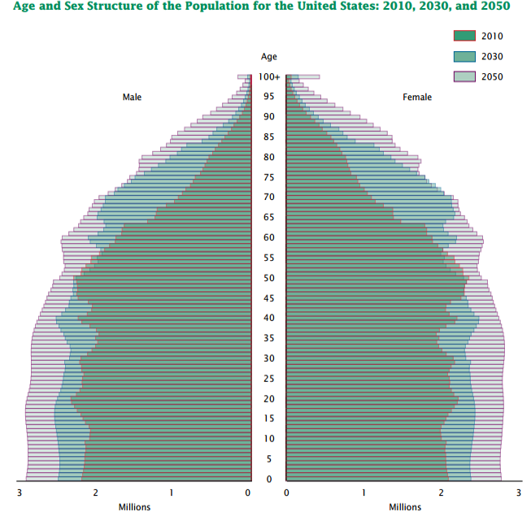
The Aging Population
1.5 Chart: (http://www.aoa.acl.gov/aging_statistics/future_growth/DOCS/p25-1138.pdf, 2008)
Notes:
Turning now to the older population, the structure and makeup of the population in the U.S. is changing over time. The United States is projected to experience rapid growth in the population 65 years and above through the year 2050. Because of our extended life span, the numbers of people age 85 and older will also dramatically increase. It is clear that long-term health care for older adults will be vitally important in the future.

Slide 88
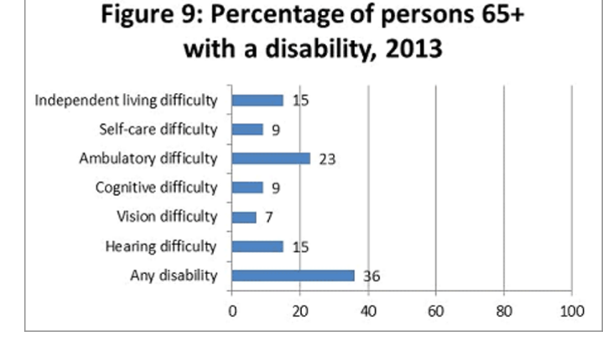
Difficulty with ADLs
(Activities of Daily Living) by Age
1.6 Chart: (http://www.aoa.acl.gov/aging_statistics/profile/2014/16.aspx, 2013)
Notes:
This lecture will often refer to “activities of daily living,” or ADLs. This term refers to personal-care tasks such as eating, bathing, dressing, moving around, and using the toilet. Difficulties with activities of daily living increases greatly with advancing age.

Slide 89
Long term care Facilities and Services
Community-based services
In-home health care
In-law apartments
Housing for aging and disabled individuals
Board and care homes
Assisted living
Continuing care retirement communities
Nursing homes
Notes:
This slide shows an overview of different types of long-term care options that are available. These options vary by location and by the level of service provided. Each option is discussed in more detail in the following slides.

Slide 90
Financial and Quality Issues - 1
Centers for Medicare and Medicaid Services (CMS)
  Provides health insurance for older adults, disabled, poor
  Covers over 30% of the U.S. population; and nearly all individuals age 65 or older
  Reimburses qualifying health care facilities
Notes:
Financing is an important issue in long-term care. Medicare and Medicaid cover health care for older, disabled, and poor Americans. The Centers for Medicare and Medicaid Services, or CMS, is the largest health care insurer in the U.S. CMS covers over 30% of the U.S. population and nearly all people who are 65 years and older.
Another important function of CMS is to provide reimbursement for health care centers that meet its criteria for health and safety. Many of the health care facilities discussed in this lecture are eligible for Medicare and Medicaid reimbursement.

Slide 91
Financial and Quality Issues - 2
The Joint Commission
  Independent nonprofit agency
  Performs on-site visits
  Health care facilities volunteer for certification
Notes:
Another important organization to know about is The Joint Commission. This is an independent, nonprofit agency that evaluates and accredits medical care facilities for quality and safety. The Joint Commission performs on-site visits to hospitals, nursing homes, urgent care centers, home care organizations, mental health care programs, and other facilities. Accreditation is not mandatory, but it is an important factor in Medicare approval for reimbursement.

Slide 92
Home Health Care - 1
Home health care is assistance with ADLs and chores inside the home
  Family, friends, volunteers may help
  Community services may be available
  Skilled nursing is needed for medical issues
  May be reimbursed by Medicare
Notes:
There are various options for long-term care. The simplest is for people to receive help with activities of daily living and housework in their own homes, perhaps from family, friends, or volunteers. Some communities offer free or low-cost services such as health aides, personal care aides, medical equipment, home modifications, and respite care. Respite care refers to a brief period of assistance so that family caregivers can take a break. Individuals with health issues need home nursing care from a licensed health care worker, which means a registered nurse, a licensed practical nurse, or a licensed therapist. Medicare pays for this care in certain cases.

Slide 93
Home Health Care - 2
Home health care agency is another option
  Professional service
  May be reimbursed by Medicare
  Includes hospice care (end-of-life care)
Notes:
Instead of relying on family or friends, people can also hire a professional home health care agency. Some of these agencies are reimbursed by Medicare, or families pay the costs themselves. Costs vary based on region of the country and the scope and frequency of care. Home health care agencies can also provide hospice or end-of-life care.

Slide 94
Board and Care Homes
(Group Homes) - 1
For people who cannot live alone and need help with ADLs
  Residents may
    Physical or mental disability
    Cognitive impairment
    Substance abuse
    Elderly
Notes:
Group homes, often called board and care homes, are group living arrangements for people who need help with activities of daily living and are not able to live alone, but do not need nursing care. The residents of a group home may have physical disabilities, mental or developmental problems, mental illness, cognitive impairment, or substance abuse. It is important to note that not all residents are elderly.

Slide 95
Board and Care Homes
(Group Homes) - 2
Meals are provided, but medical care is not
Services, quality, and fees vary widely
May be paid in part by private insurance, Medicare/Medicaid, other assistance
Notes:
Meals are included at board and care homes, but medical services are not.
The services, quality, and fees vary widely, and group homes may be licensed or not.
Sometimes private insurance, Medicare and Medicaid, or other assistance programs help pay for care.

Slide 96
Assisted Living - 1
Own room or apartment in a large complex
Assistance available 24 hours a day
Offers social/recreational activities, housekeeping and laundry
Medical services may be available on site
Service plan is individualized
Notes:
Another group living arrangement is called assisted living. Most people who use assisted living are elderly.
In this option, the residents usually have their own rooms or apartments in a large complex. They receive assistance with activities of daily living and other practical matters, such as transportation to doctor’s appointments. Assistance is available 24 hours a day, but the goal is to maintain independence.
Dining facilities are available, and most facilities offer social and recreational activities as well as housekeeping and laundry services. Medical care may be available on site.
Assisted living communities may be free-standing buildings located in retirement communities or near nursing homes. The service plan is individualized to the resident’s needs and may change over time.

Slide 97
Assisted Living - 2
Facilities are licensed in most states
Billing is monthly rent plus fees
Insurance may cover some costs; Medicare does not
Notes:
Assisted living residences are licensed in most states. Expenses include monthly rent along with fees for extra services.
As always, prices vary by the size and quality of the facility, services provided, and area of the country. Although health insurance and long-term care insurance may cover some of the costs of assisted living, Medicare does not.

Slide 98
Continuing Care
Retirement Communities
Offer different types of housing, depending on the level of assistance needed
  Separate homes/apartments for independent living
  Assisted living facility for help with ADLs
  Nursing home on site
May be accredited or not
Billing is a large entry fee plus monthly payments
Notes:
Continuing care retirement communities offer various types of housing and levels of care, depending on the resident’s needs. Relatively independent people live in separate homes or apartments. As their needs change, they can move into an assisted living facility for help with activities of daily living, and eventually into a nursing home on-site. These communities may or may not be accredited by an independent, nonprofit agency called the Commission on Accreditation of Rehabilitation Facilities. Charges entail a large entry fee followed by monthly payments.

Slide 99
Nursing Homes
Care for people who cannot live in home or community
  May have medical, physical, mental problems
  Facilities help with ADLs, provide nursing care
  Some are hospital-like, others are home-like
  Services include medical, nursing, personal care
  Physician draws up a plan of care
  Nursing care pertains to medications, acute conditions, rehabilitation, special care units
Facility should be licensed/accredited, although Medicare usually does not pay
Notes:
Nursing homes are intended for people who cannot remain at home or in the community because of medical issues or other physical or mental problems. Although we think of nursing homes as long-term care for the elderly, younger people sometimes need temporary nursing home care. Nursing homes provide round-the-clock assistance with activities of daily living and health care. Some are set up like hospitals, while others are more like a home, with kitchens for residents, units where couples live together, and social activities.
Typically, a physician formulates a care plan when the resident moves in. Nursing care is delivered by registered nurses or licensed practical nurses, and there are usually other services available such as rehabilitation and occupational therapy. Some nursing homes have special units for people with specific problems, such as Alzheimer’s disease.
Technically, a nursing home is categorized as a “nursing facility” or “skilled nursing facility.” Regardless, the nursing home should always be licensed and certified. Medicare does not pay for nursing homes except for certain cases of short-term nursing care. As usual, both services and prices vary widely.

Slide 100
Other Long Term Care
Options for Older Adults - 1
Community-based services
  Various programs, coordinated by state agencies
  State Medicaid may help with costs
In-law apartments
  Defined as a separate living space on a property
  Subject to local and state laws
Notes:
This slide reviews additional long-term care options.
First, communities may offer various free or low-cost services for elderly or disabled people. These may include transportation, Meals-on-Wheels, personal care, assistance with errands or housekeeping, adult day care, and senior centers with social and recreational activities.
Local programs are coordinated by state agencies. State Medicaid may pay for home health care, skilled nursing care, personal care, medical equipment, and other health services.
An in-law apartment is a separate living space within a single-family home that has its own kitchen and bathroom. Local or state law may restrict the ability to have an in-law apartment on a property.

Slide 101
Other Long Term Care
Options for Older Adults - 2
Subsidized housing
  Provide residence for older adults/disabled/poor, other services
  Federal or state agency funds the program
  Billing is a percentage of monthly income
Notes:
Finally, subsidized housing may be available for elderly or disabled persons through the U.S. Department of Housing and Urban Development. These are often housing complexes where residents live in their own apartments and may be able to obtain assistance with practical tasks such as meals, shopping, laundry, and housekeeping. People must qualify for this housing based on low income and then apply to a federal or state agency. Often there is a waiting list because of the high demand. Billing is done as a percentage of monthly income.

Slide 102
Hospice Care
Intended for patients with a terminal illness
Focus is palliative, or comfort care
Care is provided at home, dedicated hospice facility, hospital, assisted living facility, or nursing home
Services available depend on type of program
Home care workers should be licensed/bonded
Contact with family is an important focus
Notes:
Hospice are is intended for patients with a terminal illness, meaning an illness that is expected to be fatal within about six months. The focus of hospice care is palliation, which means providing comfort care and pain relief rather than treatments to prolong life. Palliative care is provided at home or in a dedicated hospice facility, hospital, assisted living facility, or skilled nursing facility.
The hospice services that are available depend on the type of program. Besides care from physicians and nurses, the program may include other health care providers, such as physical therapists; use of medical equipment; psychological, spiritual, and grief counseling; social services; help with activities of daily living and household tasks; and respite care. Hospice workers that come into a home should be licensed and bonded, although sometimes volunteers assist with hospice care. An important priority is that the patient should have continued access to family and other loved ones.

Slide 103
Legal and Ethical Issues
Patients may/may not be able to make decisions
Family may not be available; patient may need legal guardian
Patient has right to participate in important decisions
Long term care facilities have ethical/legal obligations
Notes:
End-of-life care and long-term care involve unique ethical and legal issues. Most important, older patients may have conditions such as dementia or cognitive difficulty that leave them unable to make medical decisions. If support from family members is not available, a guardian may have to be legally appointed.
All patients have the rights of self-determination and decision making if they are capable. This includes the right to participate in decisions about long-term care placement and the right to refuse treatment.
An important concept in medicine is informed consent, or giving permission for treatment after understanding the risks and benefits. All adults should make sure they have certain legal documents in place to let others know their wishes. Advance directives and living wills detail the medical care a person would want if he or she were incapacitated. A do-not-resuscitate order, or DNR, prevents the use of cardiopulmonary resuscitation or other extreme measures in cases of cardiac arrest. A power of attorney for health care is a document that designates another person to make medical decisions. Long-term care facilities have ethical and legal obligations to abide by patients’ wishes.

Slide 104
Long Term Hospitals
Acute-care hospitals that provide prolonged care (for more than 25 days)
Patients may have complex medical problems
  May come from intensive care units
  May have more than one condition
  May need rehabilitation
Medicare covers hospital stay if hospital is certified
Notes:
Long-term hospitals are technically defined as acute care hospitals that provide care for more than twenty-five days, on average, per patient. Sometimes patients come from intensive care units, have multiple medical problems, and need rehabilitation. Medicare covers the services provided in certified hospitals.

Slide 105
Specialty Hospitals,
Rehabilitation Care - 1
Specialty hospitals focus on particular diseases or medical fields
  Common examples are cardiology, orthopedics, women’s health, and surgery
  Less common example: end-stage kidney disease
Notes:
Some hospitals focus on particular medical specialties. Typically these are categorized as cardiac, orthopedic, women’s health, and surgical hospitals.
Other hospitals are dedicated to specific medical conditions, such as end-stage kidney disease, an incurable disease for which patients need regular dialysis or a kidney transplant in order to survive.

Slide 106
Specialty Hospitals,
Rehabilitation Care - 2
Rehabilitation hospitals
  Stand-alone hospitals or units within a hospital
  Provide intensive daily rehabilitation
Outpatient rehabilitation is also available through agencies, clinics
Notes:
Rehabilitation hospitals are either stand-alone specialty hospitals or separate rehabilitation units within acute care hospitals. In either case, patients stay in the hospital and participate in intensive rehabilitation services at least three hours per day.
Outpatient rehabilitation services may be accessed through rehabilitation agencies, rehabilitation clinics, and public health agencies. Sometimes rehabilitation includes physical therapy, occupational therapy, and speech and language therapy.

Slide 107
Psychiatric Hospitals
Psychiatric care has evolved
  Hospitalization is voluntary in most cases
Many types of care exist
  Open units
  Crisis stabilization units
  Medium-term units
  Juvenile wards
  Long term care psychiatric hospitals
Some psychiatric hospitals specialize in certain illnesses or addictions
Notes:
Psychiatric care has come a long way from the days of the insane asylum. Most important is that patients can no longer be institutionalized without their consent unless they are a clear danger to themselves or others.
There are many types of psychiatric hospitals. Open units provide treatment for patients without severe illness, where the goal is eventual discharge.
A crisis stabilization unit is like an emergency room for psychiatric patients, where violent or suicidal persons are treated. Hospitalization is enforced by court order if necessary.
Medium-term units provide psychiatric care for several weeks while the patient is monitored for response to medications.
Children and adolescents may be treated in psychiatric hospitals dedicated to pediatrics, or in juvenile wards of a psychiatric hospital.
Long-term care psychiatric hospitals provide mental health care for years, if necessary.
A high level of security is generally provided to safeguard patients.
Some institutions also specialize in certain illnesses, such as schizophrenia.

Slide 108
Day Hospitals
Provide mental health treatment during the day
Considered an alternative to outpatient care
Most facilities are hospitals or community centers
Provide individual/group therapy, other treatments
Goal is for patient to function within community
Notes:
A day hospital provides mental health treatment during the day, and the patient goes home at night. Day treatment is considered an alternative to outpatient care and is distinct from hospitalization, residential treatment services, and day care services. Treatment is tailored to adults or children. The services are provided at least one day a week in a hospital, community mental health center, or other facility. Services may include individual and group psychotherapy, other mental health treatments, and/or family education. Day-hospital care is intended to improve the patient’s ability to function in the community.

Slide 109
Community Mental
Health Centers
Provide treatment for elderly, adults, or children
Patients have chronic mental illness or recent hospital discharge
Services include outpatient care, emergency care, partial hospitalization, rehabilitation
May be reimbursed by Medicare
Notes:
A community mental health center provides services for individuals of all ages who have a chronic mental illness or were recently discharged from a psychiatric hospital. Community mental health centers provide outpatient care, twenty-four-hour emergency care, day treatment or partial hospitalization, and psychosocial rehabilitation to help patients eventually function on their own. Facilities that meet these criteria are reimbursed for services by Medicare.

Slide 110
Substance Abuse
Treatment Centers
Help patients overcome drug and/or alcohol abuse
Various facilities
  Residential treatment centers
  Outpatient programs
  Hospitals
Programs may specialize
  By drug (for example, cocaine addiction)
  By age group (for example, adolescents)
Notes:
Substance abuse treatment centers help individuals recover from drug and/or alcohol abuse. Types of facilities include residential treatment centers, outpatient treatment programs, and hospitals. The center may specialize in treating a certain form of drug abuse, such as alcoholism or cocaine addiction, or a certain age group, such as adolescents.

Slide 111
Delivering Health Care, Part 1
Summary – Lecture d
Multiple health care options exist
Locations - school, home, community, hospital
Large variation exists in services, quality, costs
Facilities may or may not be licensed/certified
Services may or may not be reimbursed by Medicare/Medicaid
Complex financial, legal, ethical issues apply
Need for elder care will only grow in the future
Notes:
This concludes lecture d of Delivering Health Care, Part 1.
This final lecture described different types of long-term care facilities.
In short, multiple health care options exist for medical needs, mental health problems, and substance abuse, as well as end-of-life care through hospice.
The location of care might be a school, the home, a community facility, or a hospital.
Variations are evident in the types, quality, and costs of long-term care, in part because facilities may or may not be certified for reimbursement by Medicare and Medicaid.
Care for older adults raises complex financial, legal, and ethical issues, and census data indicates that the need for elder care will only increase as the demographics of the populations change.

Slide 112
Delivering Health Care, Part 1
Summary
Described the organization of health care at the federal, state and local levels
Described the organization of the VA system and Military Health System
Described the structure and function of hospital clinical and administrative units
Described different types of long term care facilities, with an emphasis on their function
Notes:
This concludes the unit Delivering Health Care, Part 1.
In summary, this unit described the organization of health care at the federal, state, and local levels, including the VA system and Military Health System, as well as the structure and function of hospital clinical and administrative units. Finally, it described the various types of long-term care facilities, with an emphasis on their function.

Slide 113
Delivering Health Care, Part 1
References – 1 – Lecture d
References
Administration for Community Living. http://www.aoa.acl.gov/aging_statistics/future_growth/DOCS/p25-1138.pdf. Accessed January 20, 2017.
American Health Care Association, National Center for Assisted Living. Consumer information about long term care. https://careconversations.org/types-care. Accessed January 20, 2017.
American Hospital Association. Long term acute care hospitals. http://www.aha.org/aha_app/issues/Medicare/Long-Term-Care-Hospitals/index.jsp. Accessed January 20, 2017.
Centers for Medicare & Medicaid Services. https://www.cms.gov. Accessed January 20, 2017.
Cobbs, E. Legal and ethical concerns at the end of life. In: The Merck Manual. http://www.merckmanuals.com/home/fundamentals/death-and-dying/legal-and-ethical-concerns-at-the-end-of-life. Accessed January 20, 2017.
Commission on Accreditation of Rehabilitation Facilities International. Who we are. http://www.carf.org/About/WhoWeAre. Accessed January 20, 2017.
Notes:
References slide. No audio.

Slide 114
Delivering Health Care, Part 1
References – 2 – Lecture d
References
Family Caregiver Alliance. Residential care options. https://www.caregiver.org/residential-care-options. Accessed January 20, 2017.
Medicare.gov. Long-term care. https://www.medicare.gov/coverage/long-term-care.html. Accessed January 20, 2017.
MedlinePlus. Long-Term Care. http://nihseniorhealth.gov/longtermcare/whatislongtermcare/01.html. Accessed January 20, 2017.
National Association for Home Care & Hospice. Home care and hospice basics. http://www.nahc.org/consumer-information/home-care-hospice-basics. Accessed January 20, 2017.
Pace B. Hospice care. JAMA. 2006;295(6):712.
School-based Health Alliance. About school based health centers. http://www.sbh4all.org/school-health-care/aboutsbhcs/. Accessed January 20, 2017.
The Joint Commission. http://www.jointcommission.org. Accessed January 20, 2017.
Notes:
References slide. No audio.

Slide 115
Delivering Health Care, Part 1
References – 3 – Lecture d
References
U.S. Department of Health and Human Services. Administration for Community Living. http://www.aoa.acl.gov/aging_statistics/future_growth/DOCS/p25-1138.pdf. Accessed May 4, 2016.
U.S. National Institutes of Health. National Institute on Aging. Legal and Financial Planning. https://www.nia.nih.gov/health/featured/legal-financial-planning. Accessed May 6, 2016.
Wiener JM, Hanley RJ, Clark R, Van Nostrand JF. Measuring the activities of daily living: comparisons across national surveys. Office of Disability, Aging and Long-Term Care Policy. March 9, 1990. http://aspe.hhs.gov/daltcp/reports/meacmpes.htm. Accessed May 6, 2016.
Notes:
References slide. No audio.

Slide 116
Delivering Health Care, Part 1
References – 4 – Lecture d
Charts, Tables, and Figures
1.5 Chart: Age and Sex Structure of the Population for the United States: 2010, 2030, and 2050. Available from http://www.aoa.acl.gov/aging_statistics/future_growth/DOCS/p25-1138.pdf. Accessed May 4, 2016.
1.6 Chart: Bar chart depicting the percentage of persons over age 65 with a disability; 2013. Available from http://www.aoa.acl.gov/aging_statistics/profile/2014/16.aspx. Accessed May 4, 2016.
Notes:
References slide. No audio.

Slide 117
Introduction to Health Care and Public Health in the U.S.
Delivering Health Care, Part 1
Lecture d
This material was developed by Oregon Health & Science University, funded by the Department of Health and Human Services, Office of the National Coordinator for Health Information Technology under Award Number 90WT0001.
Notes:
No audio.

